Slide 1
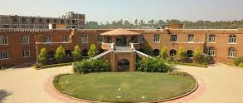
INTRODUCING THE FACULTY OF GRADE 01

Slide 2
Ms. Shanthi Menon Founder Principal

Slide 3
MS. Hemlata Pande – Principal

Slide 4
Ms. Kavitha Mohan
Head Mistress.

Slide 5
MS. SARITA DARAK
CLASS TEACHER FOR GRADE 1A FACULTY FOR MATHEMATICS, EVS - 1A
FACULTY FOR ENGLISH -1A, 1C

Slide 6
MS. GOPIKA NARAYAN- CLASS TEACHER FOR GRADE 1B FACULTY FOR MATHEMATICS EVS AND ENGLISH

Slide 7
MS. SANGITA MAJUMDER -
CLASS TEACHER FOR GRADE 1C –FACULTY FOR HINDI AND EVS

Slide 8
MS. KIRAN SASHIDHAR
CLASS TEACHER FOR GRADE 1D
FACULTY FOR MATHEMATICS - 1D
FACULTY FOR EVS - 1C, 1D

Slide 9
MS. NIDHI SHARMA
CLASS TEACHER FOR GRADE 1E
FACULTY FOR MATHEMATICS - 1E
FACULTY FOR COMPUTERS 1A -1E

Slide 10
MS. SARU SKARIA
FACULTY FOR ENGLISH - 1D

Slide 11
MS. PAYAL DESAI
FACULTY FOR ENGLISH AND EVS GRADE 1E

Slide 12
Ms. Tarannum Fatima - Quiz

Slide 13
MS. MUBEENA–FACULTY FOR HINDI 1A,1D,1E AND FACULTY FOR III LANG (H)/ELECTIVE HINDI

Slide 14
MS. . SHOBHA R– FACULTY FOR HINDI 1B

Slide 15
MS. PUSHPALATHA- FACULTY FOR KANNADA AND KADDYA KANNADA 1A,1B

Slide 16
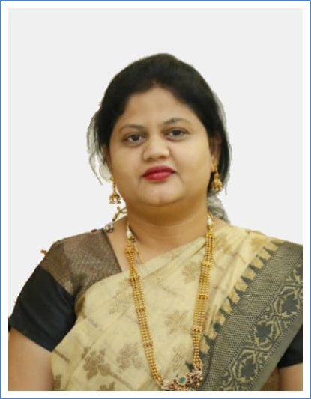
MS. NOORSABA- FACULTY FOR KANNADA AND KADDAYA KANNADA 1D,1E

Slide 17
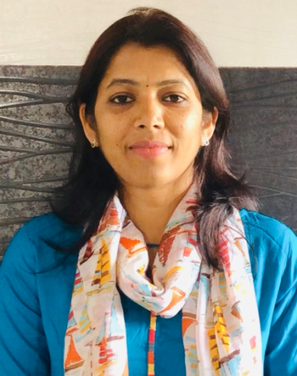
MS. SHOBHA BELLANKI
FACULTY FOR 3RD LANGUAGE KANNADA - 1C

Slide 19
MS. SATHYA THANGAVEL - ART TEACHER

Slide 20
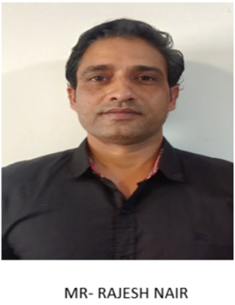
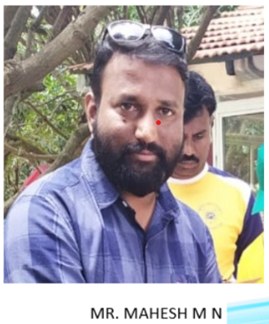
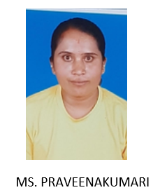
FACULTY FOR PHYSICAL EDUCATION

