Slide 1
INTRODUCING THE FACULTY OF GRADE 06

Slide 2
Ms. Shanthi Menon Founder Principal

Slide 3
MS. HEMLATA PANDE – PRINCIPAL

Slide 4
MS. KAVITHA MOHAN- HEAD MISTRESS.

Slide 5
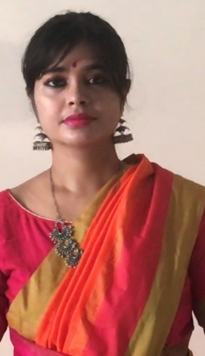
MS. ISHANI SENGUPTA -.CLASS TEACHER FOR GRADE 6 A FACULTY FOR CHEMISTRY 6A/B/C/D/E

Slide 6
MS.ARTI ARORA –CLASS TEACHER FOR GRADE 6 B FACULTY FOR PHYSICS 6B

Slide 7
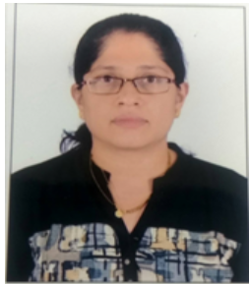
MS. CHANDAN SHENOY–CLASS TEACHER FOR GRADE 6 C FACULTY FOR ENGLISH 6C

Slide 8
MS.MOUMITA SENGUPTA : CLASS TEACHER FOR GRADE 6D- ENGLISH 6A,6B,6D

Slide 9
MS. MINI JOSE - CLASS TEACHER FOR GRADE 6E FACULTY FOR ENGLISH 6E

Slide 10
MS.ANNAM SUBRAMANIAN - FACULTY FOR MATHEMATICS 6A

Slide 11
MS. ARCHANA KUMARI - FACULTY FOR MATHEMATICS GRADE 6B

Slide 12
MR. SWETHA BUSSA FACULTY FOR MATHEMATICS 6C,6E

Slide 13
MS. PUTUL BANERJEE– FACULTY FOR MATHEMATICS 6D

Slide 14
MS. REEBA JOSEPH - FACULTY FOR PHYSICS 6A

Slide 15
MS. HARIKA –FACULTY FOR PHYSICS FOR 6C

Slide 16
MS. NUPUR GHOSAL -FACULTY FOR PHYSICS 6D,6E

Slide 17
MS. SUNITHA NAIR- FACULTY FOR BIOLOGY 6A,6B,6C

Slide 18
MR. ROMEL KUSHALAPPA - FACULTY BIOLOGY FOR 6D,6E

Slide 19
MS. SHIVANGI DE –FACULTY FOR HISTORY

Slide 20
MS. NEELAM KHALIL - FACULTY FOR GEOGRAPHY 6A,6B,6D

Slide 21
MS. SARANYA THIRUMALAI – FACUTLY FOR GEOGRAPHY 6C,6E

Slide 22
MS. JENNY CUMMINGS - FACULTY FOR COMPUTERS – 6A,6B,6C

Slide 23
MS. SHWETHA. R - FACULTY FOR COMPUTERS - 6D,6E

Slide 24
MS. TARANNUM FATIMA - QUIZ

Slide 25
MS. RAJSHREE – FACULTY FOR IIL HINDI

Slide 26
MS. MRUNAL MANKAR – FACULTY FOR HINDI 6B

Slide 27
MS. Madhu Sharma – FACULTY FOR HINDI II LANG -6C

Slide 28
MS. MANASI NAIK- FACVULTY FOR HINDI – 6D

Slide 29
MR. VENKATESHA - FACULTY FOR KANNADA

Slide 30
MS. SHREYA RAO – FACULTY FOR FRENCH

Slide 31
MS. ASHWINI MK– FACULTY FOR IIIL KANNADA/KK

Slide 32
MS. VEDAVATHI – FACUTY FOR IIIL KANNADA/KK 6E

Slide 34
MS. SATHYA THANGAVEL - ART TEACHER

Slide 35
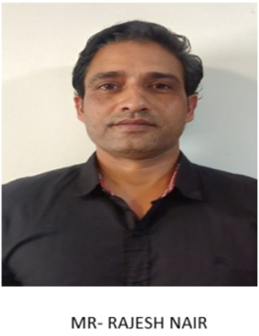
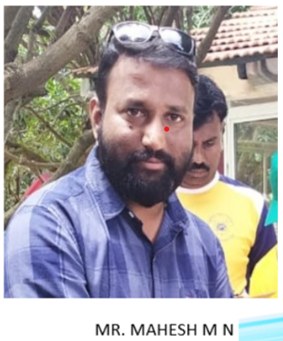
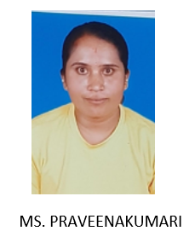
FACULTY FOR PHYSICAL EDUCATION

